Slide 1

To Do List Web Application
By Luke Edwards

Slide 2
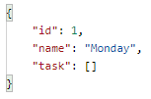
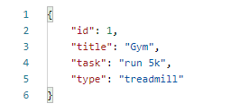
Concept
Created a task list which contained:
id
Title
Task
Type
An example of this would be:
This was created in a many to one relationship with day

Slide 3
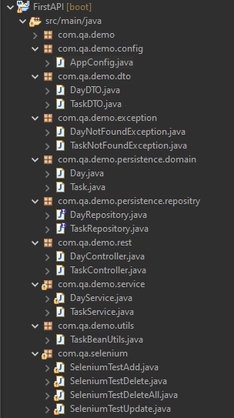
Spring Plan- what was needed:
App config
DTO
Exceptions
Day and Task domain
Repositories for both task and day
Controllers for both task and day
Services for both task and day
A utils class to manage beans
Selenium Tests
Junit tests

Slide 4
Consultant Journey
Throughout this project I was introduced to new languages and technologies, these are:
Spring (back end API dev platform)
Java (back end)
HTML (front end)
JavaScript (front end)
CSS (front end) (not used in project)
Postman (API tool)
Selenium (UI testing)

Slide 5
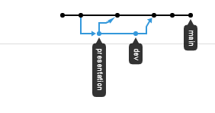
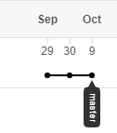
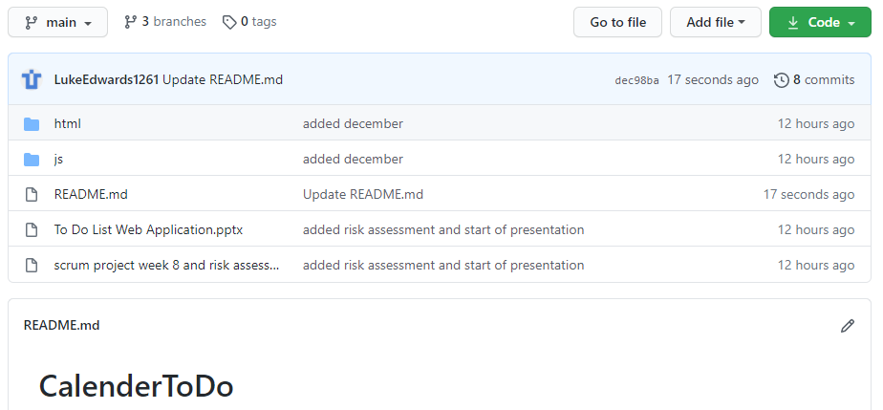
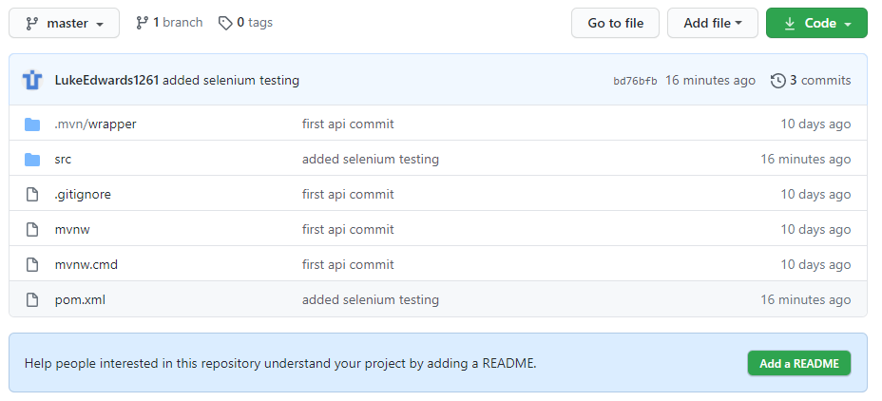
CI
Front end was used more, creating a separate branch (and merged) for presentation and other dev additions
Back end CI was hardly used

Slide 6
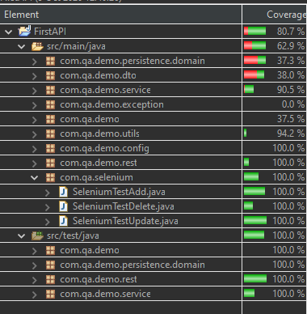
Testing
Used red green refactor for unit, integration testing and selenium testing to a standard of 80.7%

Slide 7
Demonstration
I will now show you a demo of the code I have created.

Slide 8
Spring review & retrospective
What went well:
Fully flushed out front end
High standard of testing
To be improved:
Front end is at an operational level, didn’t get to fully flush out the front end,
Completed:
Java backend
Unit and integration testing
Selenium testing
HTML frontend (barely)
JavaScript (barely)
What was left behind:
CSS to improve the visuals of the front end
Day implementation to allow for separate tables
Month implementation to allow for separate tables

Slide 9
Conclusion
With more time and learning I would have improved the visuals and functionality of the front end (HTML, Javascript and CSS)
Would have implemented Days to allow for the creation of separate tables
Would adjust the layout of the API to allow for months to function independently of eachother
Thank you for listening, any questions?

